Slide 1

&
04.21.26

Slide 2
Agenda
Introductions
Why Procurated?
Canary Features
The Survey
Sharing with Vendors
Questions & Next Steps
CONFIDENTIAL |
2

Slide 3
Why the University at Buffalo is Implementing Procurated
Purpose: strengthen supplier performance and accountability with consistent, campus-wide feedback.
What We are Solving
· No consistent, campus-wide way to capture supplier performance feedback from UB contract purchasers
· Supplier feedback has been decentralized and inconsistent
· Limited performance data has made it harder to support renewal and supplier management decisions
CONFIDENTIAL |
3

Slide 4
Why the University at Buffalo is Implementing Procurated
What Procurated Canary Enables
· Centralized supplier feedback with a simple, consistent review process for campus purchasers
· Actionable insights for renewals and supplier performance conversations, closing the loop with vendors
· National benchmarking via Procurated’s network, alongside feedback from UB faculty and staff who buy from UB contracts
CONFIDENTIAL |
4

Slide 5
Why the University at Buffalo is Implementing Procurated
Why This Matters to UB
· Improves supplier quality, service, and accountability
· Gives campus purchasers a direct way to share real-world feedback on contract suppliers
· Supports data-informed decisions and UB’s strategic procurement and process improvement goals
CONFIDENTIAL |
5

Slide 6
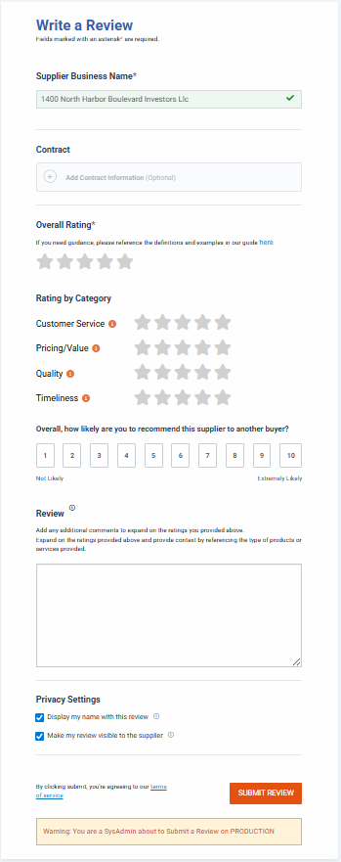

Driving Vendor Performance with Continuous Feedback
Simple & Consistent Review Form
Use Performance Data for Future Awards/Renewals
Proactively Collect Feedback from Contract End Users
Vendors Improve Performance Issues
Share Feedback with Vendors
CONFIDENTIAL |
6

Slide 7
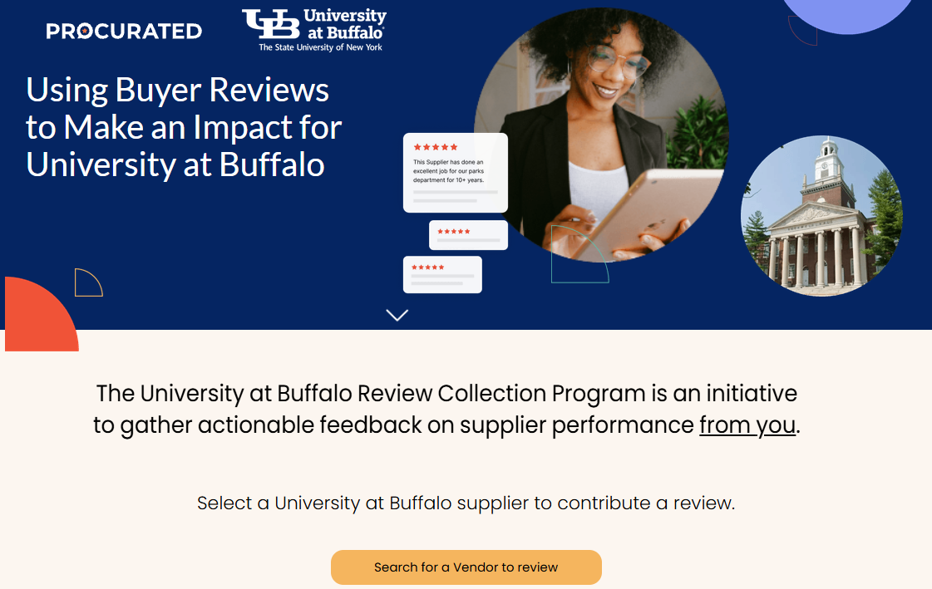

You can access reviews from the UB landing page
Include this landing page link on your intranet, contract pages, and anywhere your end users engage with procurement. You can also include the link in your email signatures!
https://go.procurated.com/University-at-Buffalo/

Slide 8
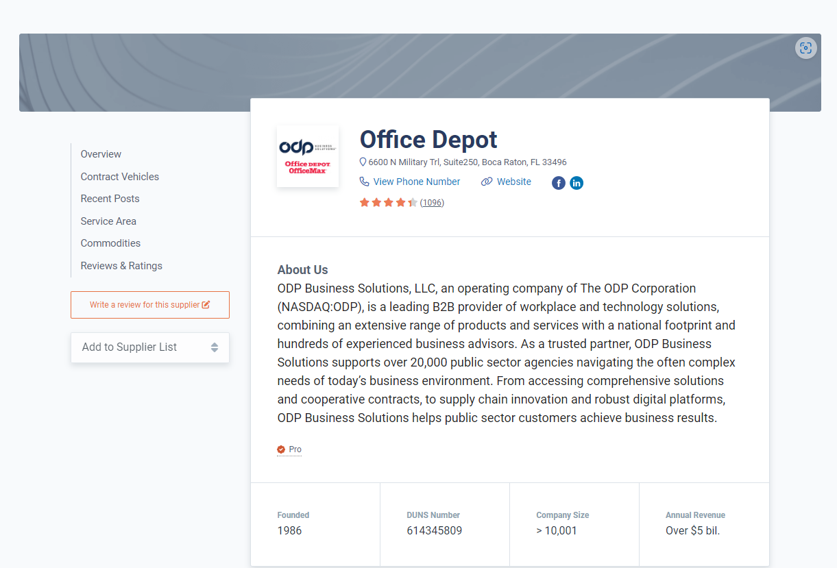
You can also access reviews directly from the supplier's page
https://app.procurated.com/suppliers/office-depot
8

Slide 9
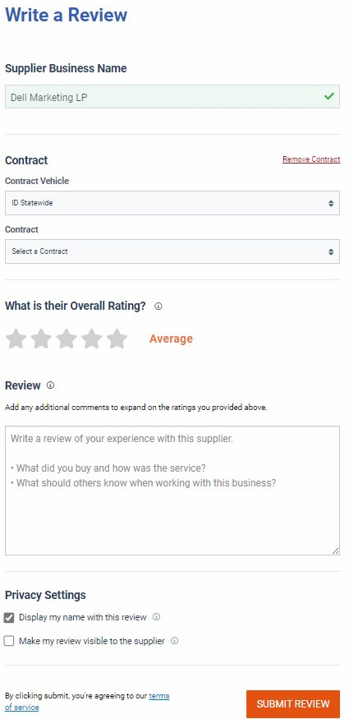
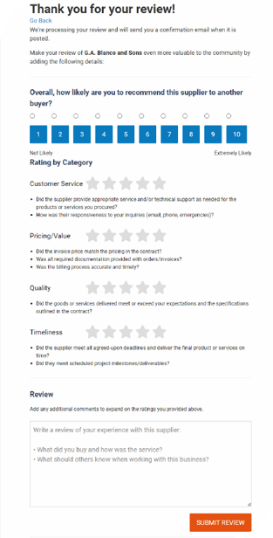
How to write a review:
Be Objective: Tell the facts about your experience. Follow the prompts on the review form.
Be Specific: Share specific feedback and provide examples. What would you tell a colleague who called you and asked for your feedback?
Be Fair: What was your overall experience? Provide both critical and positive feedback.
Be Consistent: Provide narrative that supports your ratings.
Notes:
9

Slide 10
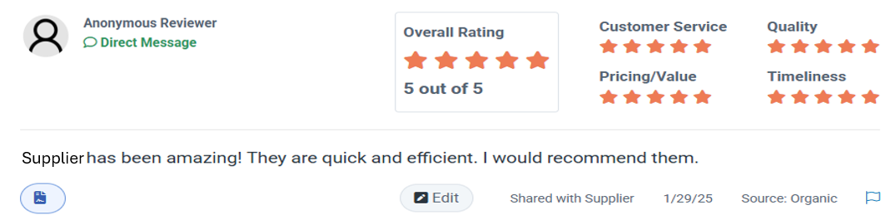
Example 1:

Slide 11
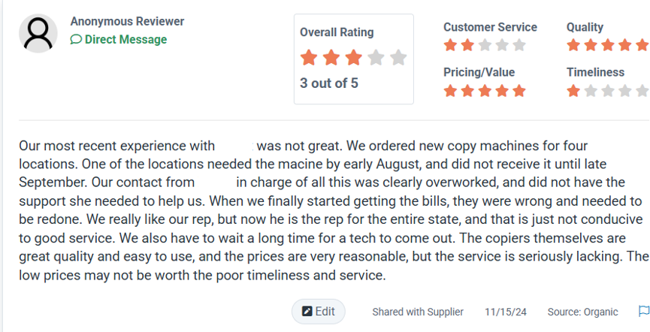
Example 2:

Slide 12

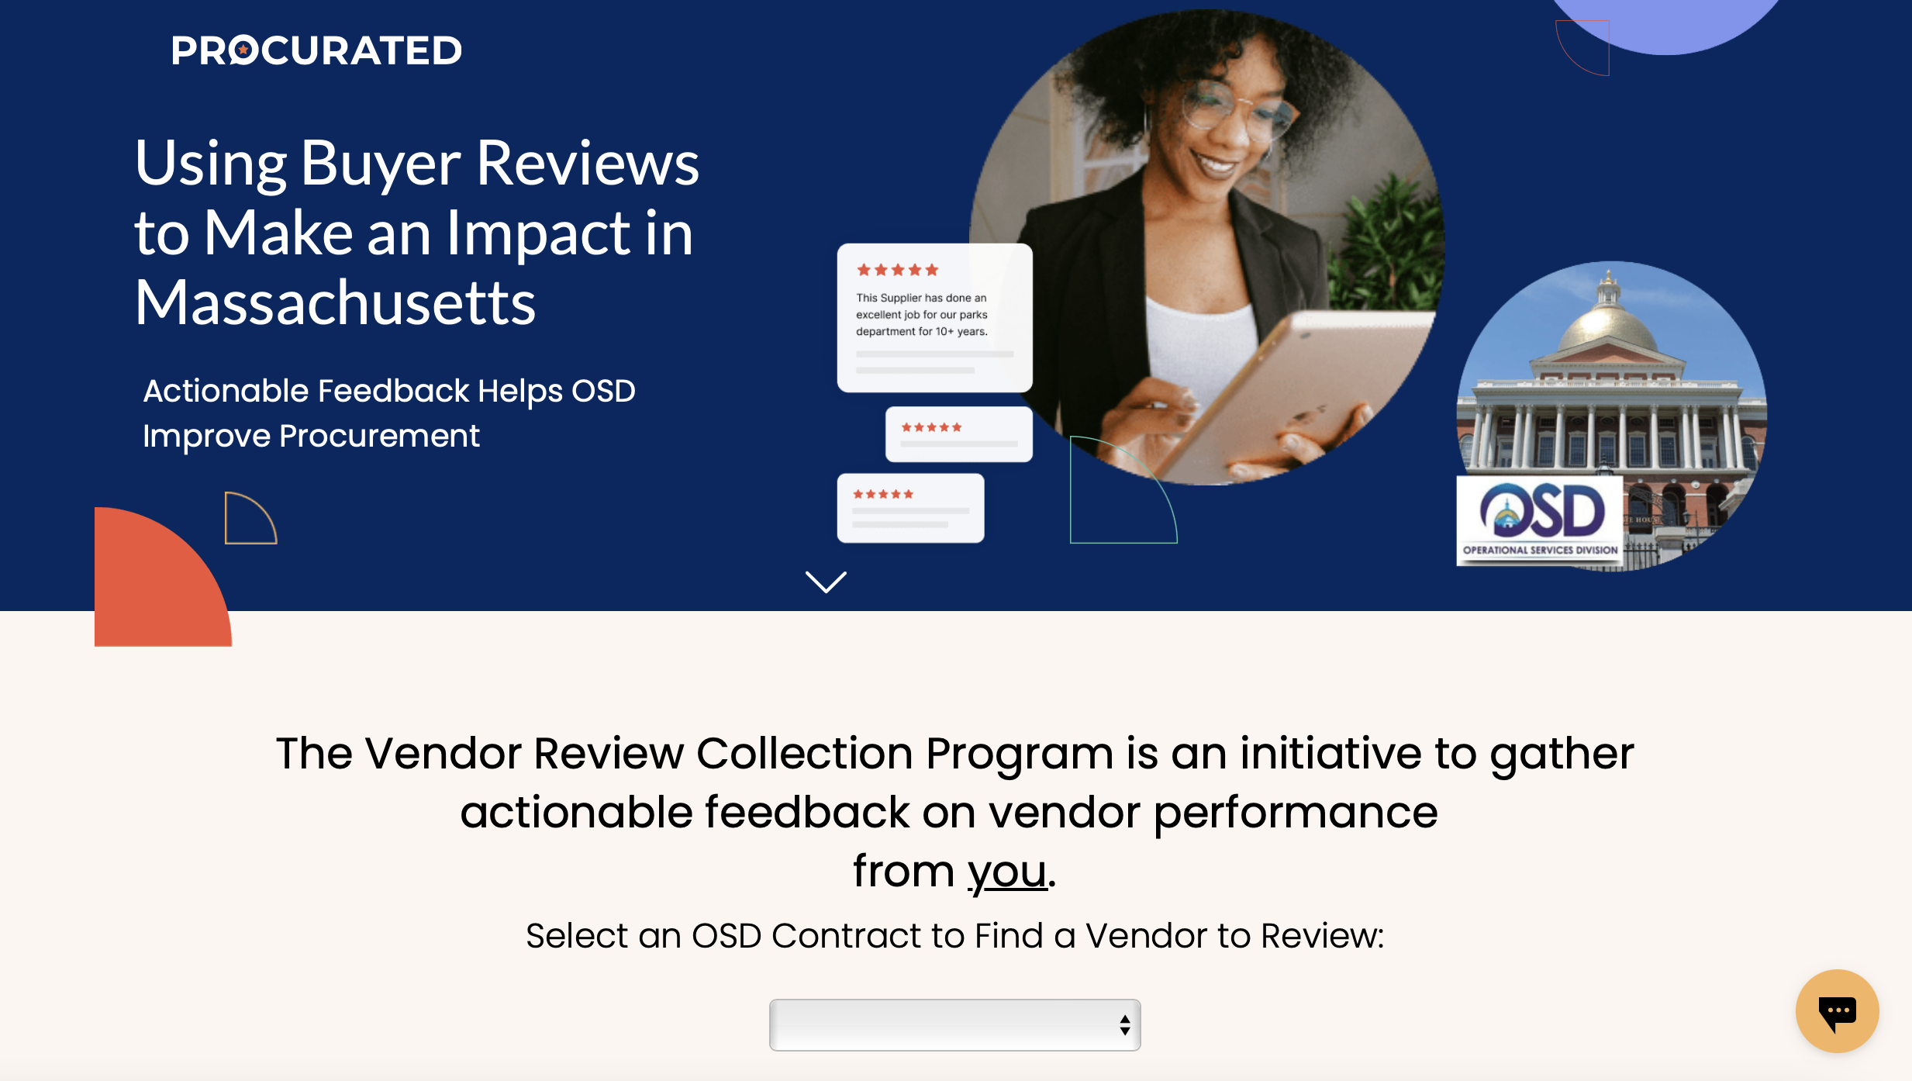
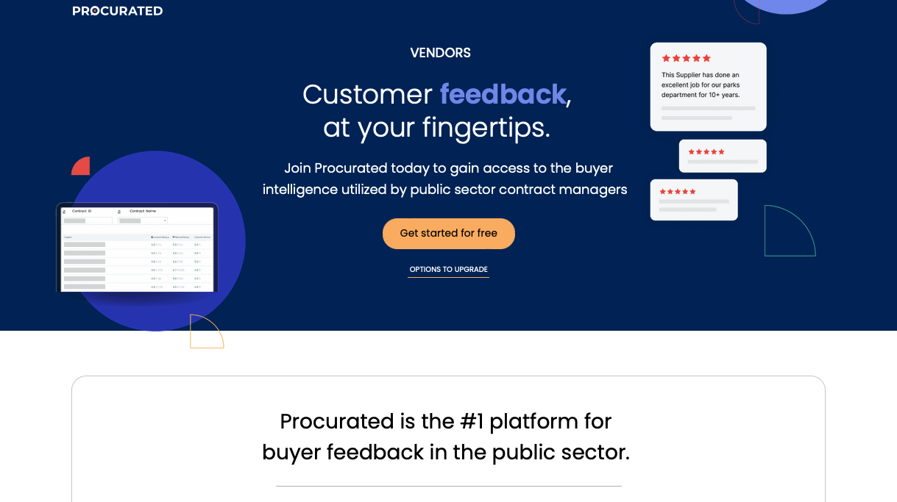
From customizing their profile to getting their own custom review links, Procurated gives suppliers additional resources to boost review gathering. Be sure to send them to our supplier resources page.
12

Slide 13
Questions?
CONFIDENTIAL |
13

Slide 14
For Ongoing Questions, please submit a ticket through the Business Services Support Hub using the ShopBlue page link and include Procurated Canary in the Summary field. You may also contact Supplier Maintenance directly at dlprsmg@buffalo.edu
CONFIDENTIAL |
14

Slide 15

Thank You!
Patrick Hogan, CSM
Pat@procurated.com
(847) 542-9909

